Slide 1

VE300 Technical Communication
Week 4
Reporting Technical and Graphical Data
Michele Campbell
Summer 2020

Slide 2
Use of Graphics and Visuals in the Report
Appearance
Colors
Clarity
Label or caption
Numbering
Precision and specificity
Reference within the text
Appropriate signaling words

Slide 3
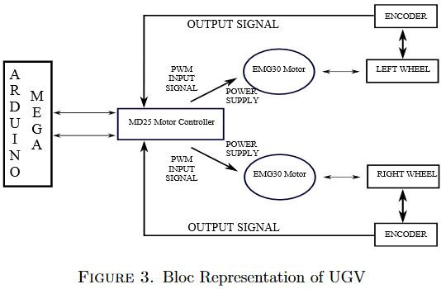
Referring to a Schematic
In Fig. 3, we have reported the on-board hardware operation scheme. The microcontroller, by means of a PWM signals, provides information to the DC motors drive to adjust the supplied voltage to the actuators. The MD25 drive is directly connected to the 12 volts on-board battery and supplies the power to the DC motors and ultrasonic sensors SRF05. The EMG30 is a 12 volts motor fully equipped with encoders and a 30:1 reduction gearbox. It is ideal for small or medium robotic applications, providing cost effective drive and feedback for the user.
Source: de Simone and Guida (2018)

Slide 4
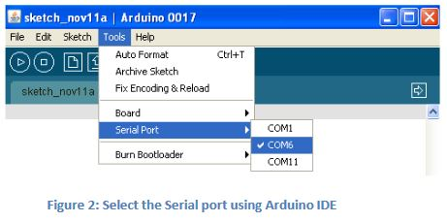
Referring to a Screenshot
Go to the Tools menu of the Arduino IDE (Figure2), and select the Serial Port (COM Port) to which the Arduino Board is connected to. This should be the last one (not COM1 or COM3). Make sure that the Arduino is plugged into one of the USB ports, otherwise you will only see COM1 and COM3.
Source: UPenn (2014)

Slide 5
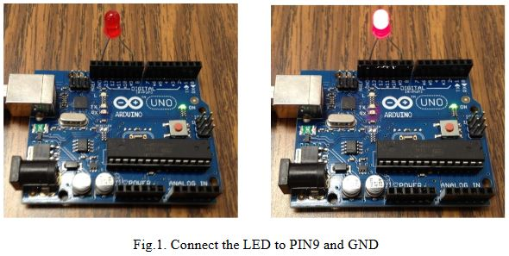
Referring to a Photograph
Before a sketch is loaded into Arduino, the “Tools” menu is used to check the port to which the Arduino board is connected. Once the right port is selected, it is possible to upload sketches to Arduino. The example sketch uses the built-in LED connected to PIN 13 and controls the time that LED turns on and turns off, separately. It is also necessary to know how to use the other digital port to control the LED. Thus, the PIN definition is changed from “int led = 13” to “int led = 9” and an LED is plugged into PIN 9 and GND, as illustrated in Fig.1.
Source: URI ELE

Slide 6
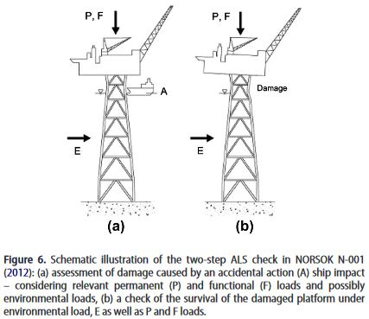
Referring to a Diagram
The structural integrity criterion in NORSOK N-001 (2012) is a two-step procedure as illustrated in Figure 6. First, the initial damage due to accidental actions with an annual exceedance probability of 10−4 is estimated by a non-linear analysis or the damage at this probability level is specified, e.g. in terms of a failure of a slender member, mooring line etc. Accidental actions include the effects of fires, explosions, ship collisions, dropped objects as well as abnormal distribution of payload or ballast. Abnormal sea loads also need to be considered in the ALS check and are also mentioned.
Source: Moan (2018)

Slide 7
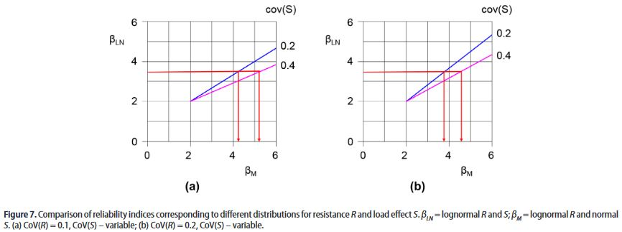
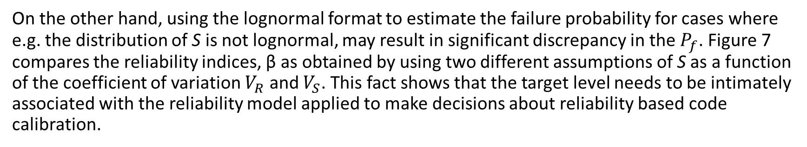
Referring to a Chart
On the other hand, using the lognormal format to estimate the failure probability for cases where e.g. the distribution of S is not lognormal, may result in significant discrepancy in the $P_{f}$. Figure 7 compares the reliability indices, β as obtained by using two different assumptions of S as a function of the coefficient of variation $V_{R}$ and $V_{S}$. This fact shows that the target level needs to be intimately associated with the reliability model applied to make decisions about reliability based code calibration.
Source: Moan (2018)

Slide 8
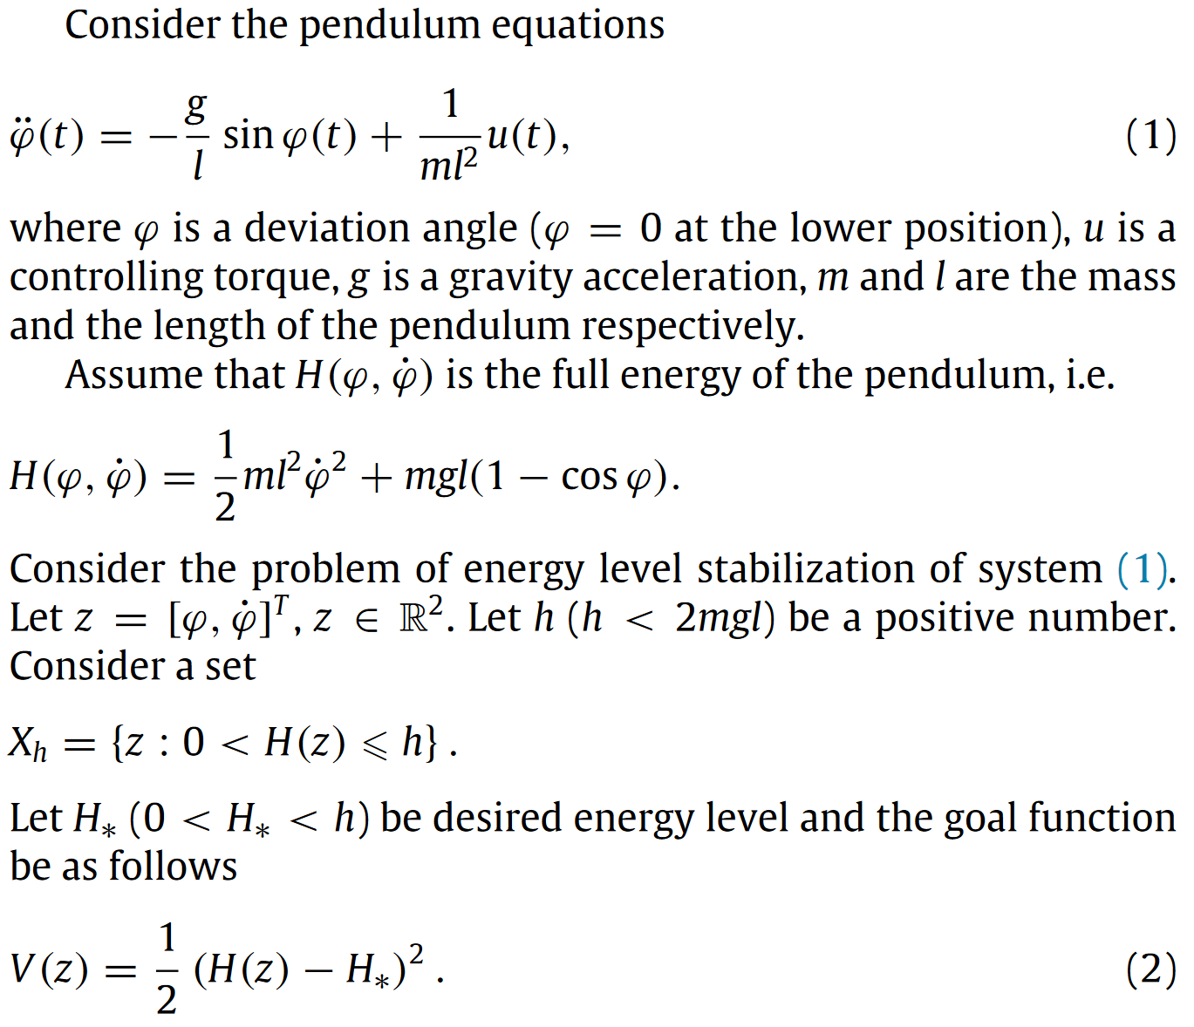
Referring to Equations
Separate the equations into the text (don’t just dump many equations onto the page and think your work is done)
Refer to each equation, both before and after
Treat the equations like a part of the sentence
Source: Ruslan et al. (2016)

